Slide 1

CyPurr Session: Mobile Security
Can’t live with it, can’t live without it, want to throw it
Over a bridge yeah…I understand
Cypurr Collective, May 15th 2021, Expiration: 11/2021

Slide 2

Overview
Intro
Mobile Security
Outro
Q/A

Slide 3
Who Are we?
We are…
To educate the public on cybersecurity in an accessible and hollistic way with fun cats.
Our work aims to resist systemic oppressions through community self-defense.
We do that with programs, events, workshops, socials and more!
Established April 2016

Slide 4
Groundrules
Saf(er) Space - We DO NOT tolerate language or behavior purposefully meant to demean or harm folks based on their identities
Webinar Mode- Send your questions through the chat, we’ll try our best to answer them through the chat, on video, or during the Q/A, depending on what’s going on.

Slide 5
Who Are we?
Slides/Resources available after! Video available soon.
A note on voice recording…
We are trying to keep these presentations for posterity, and not to record participants. Use the chat if possible for questions and discussions if you do not want your voice on the recording.

Slide 6
And now…

Slide 7
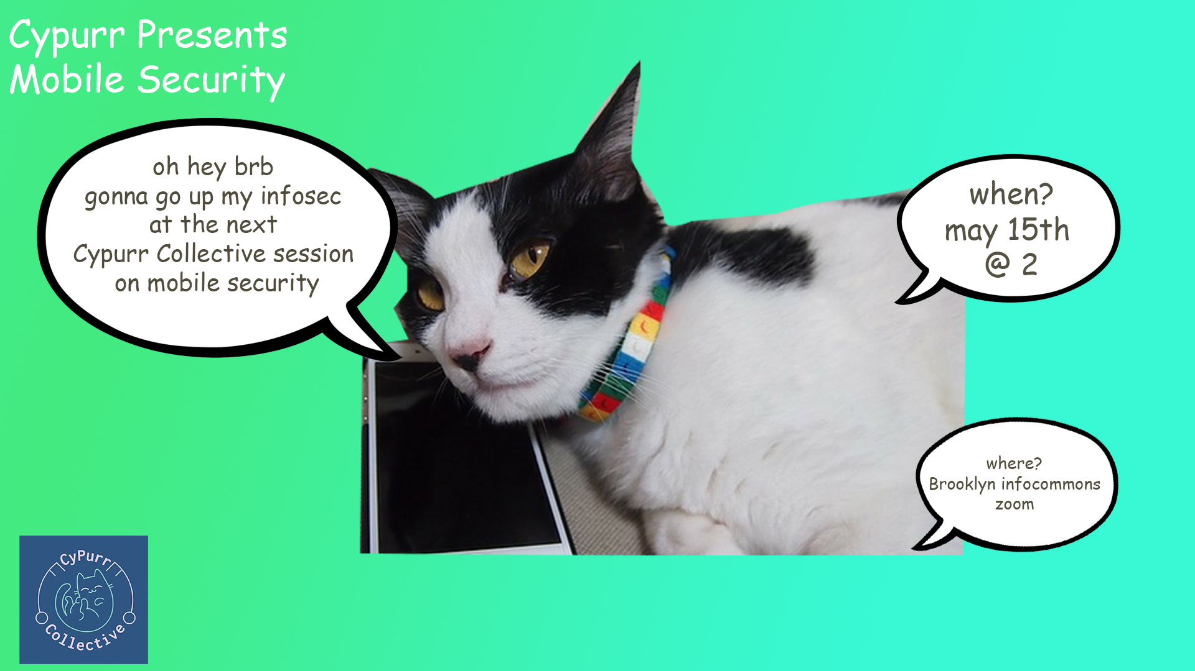

Slide 8
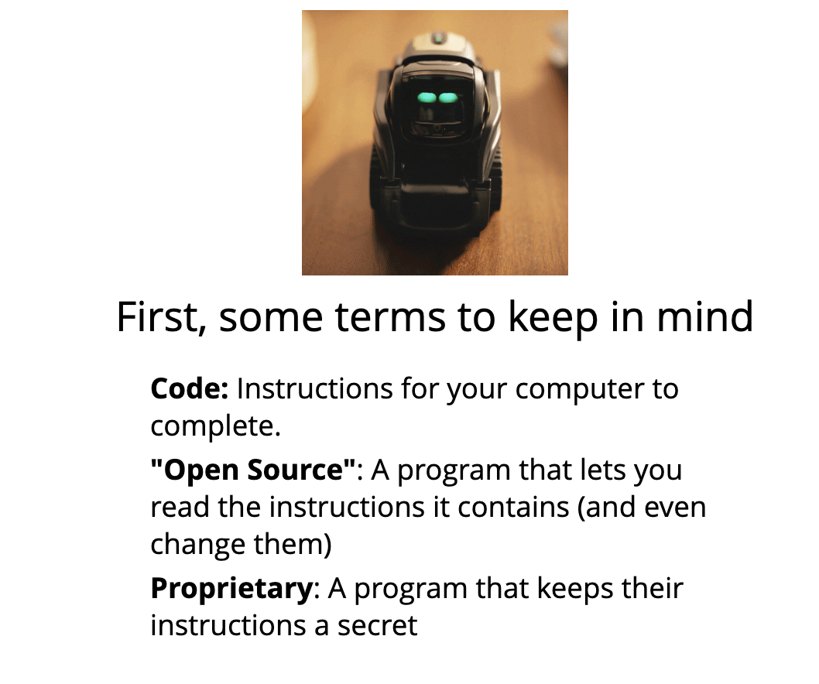

Slide 9
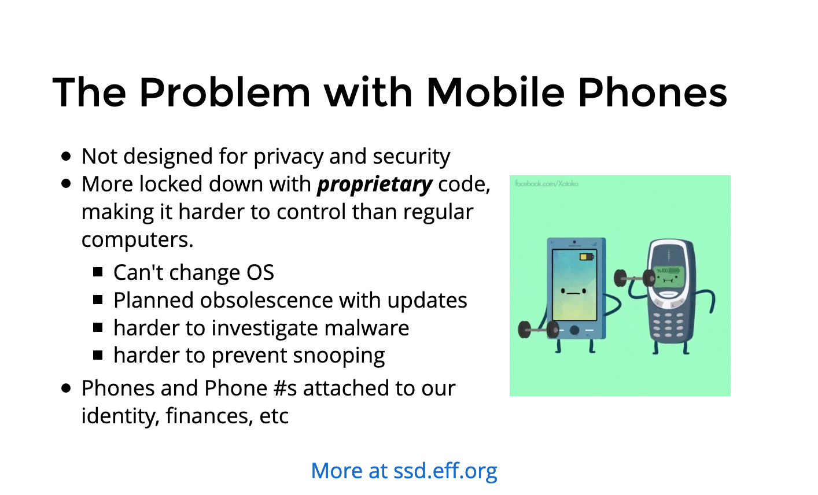

Slide 10
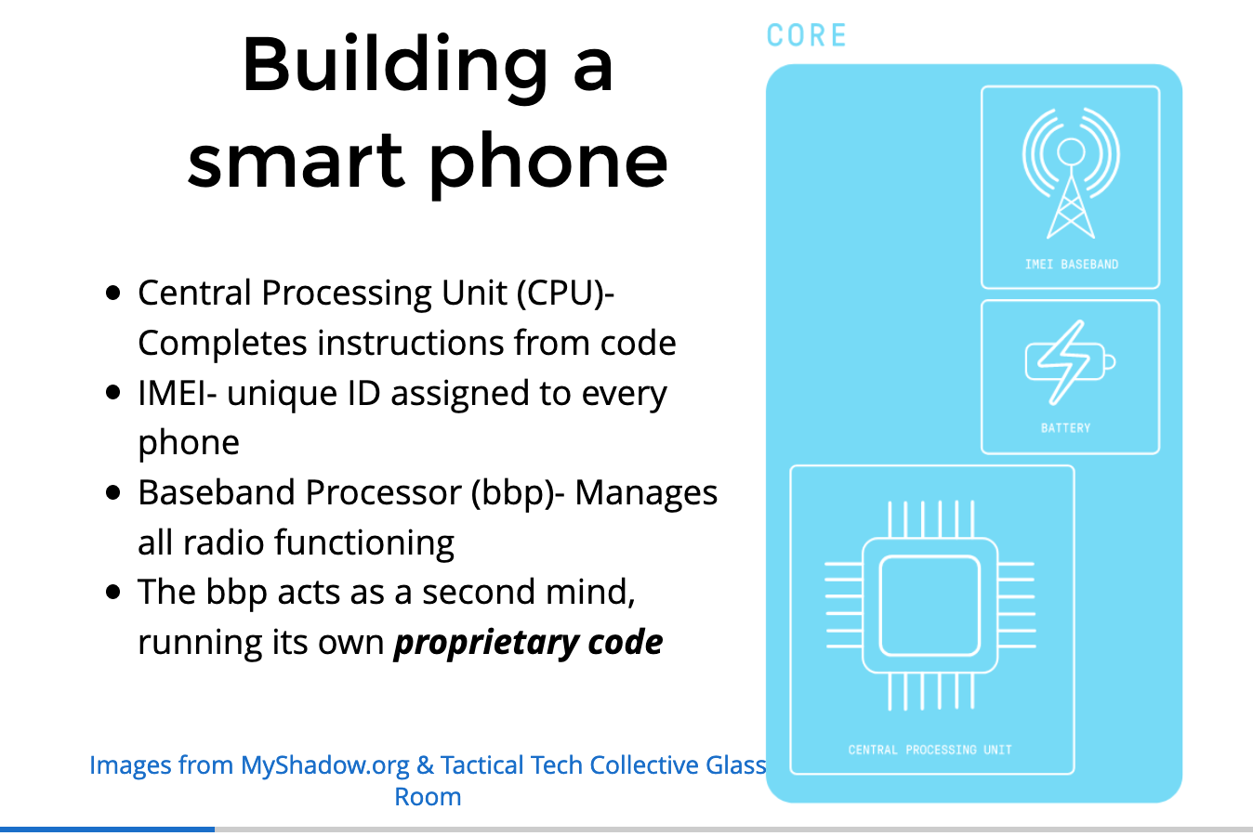

Slide 11
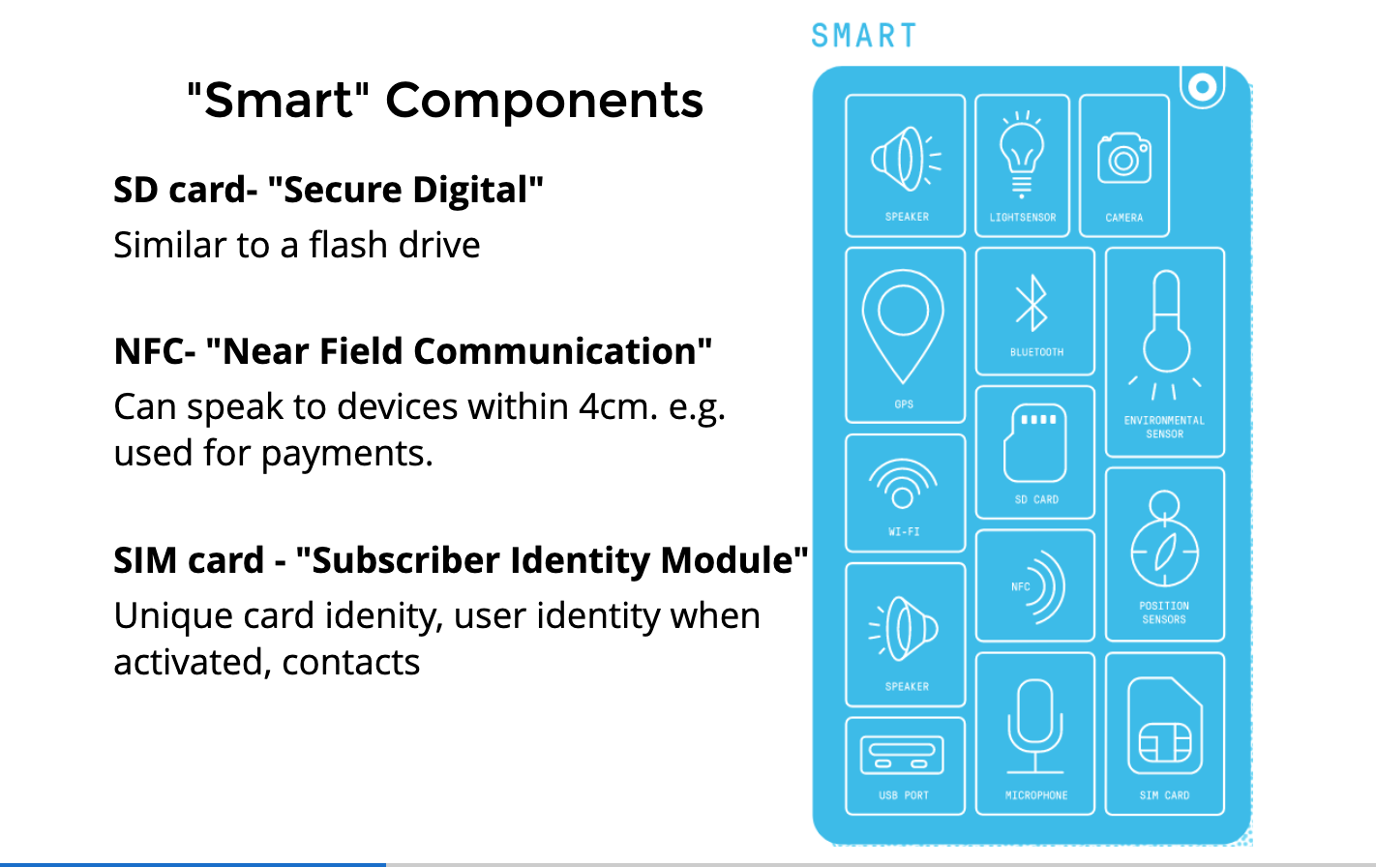

Slide 12
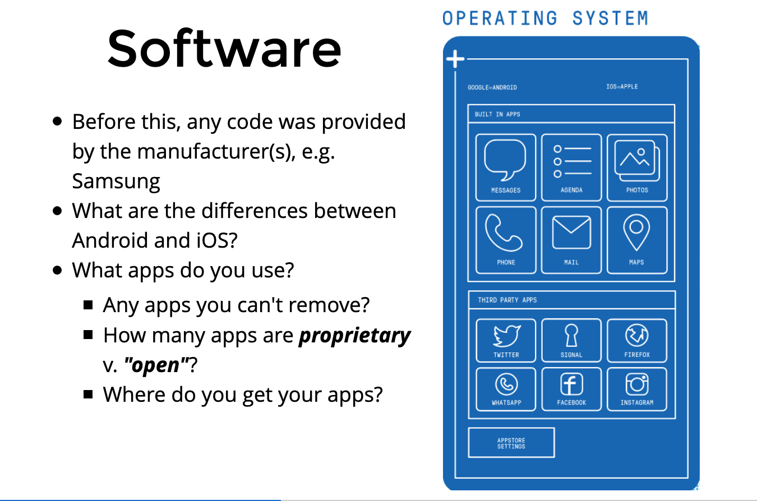

Slide 13
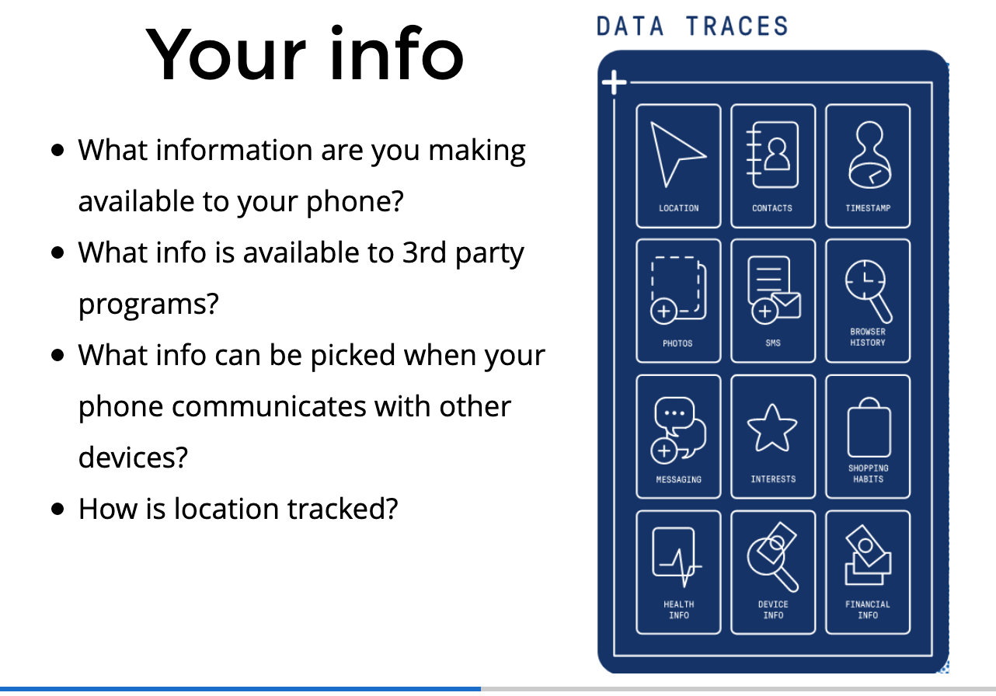

Slide 14
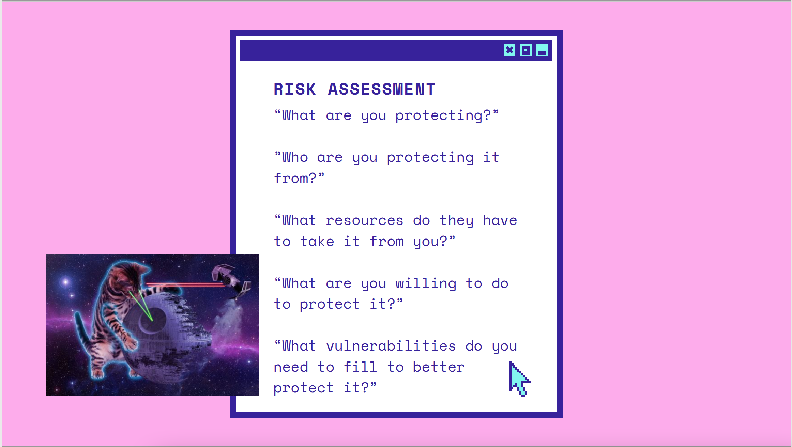

Slide 15
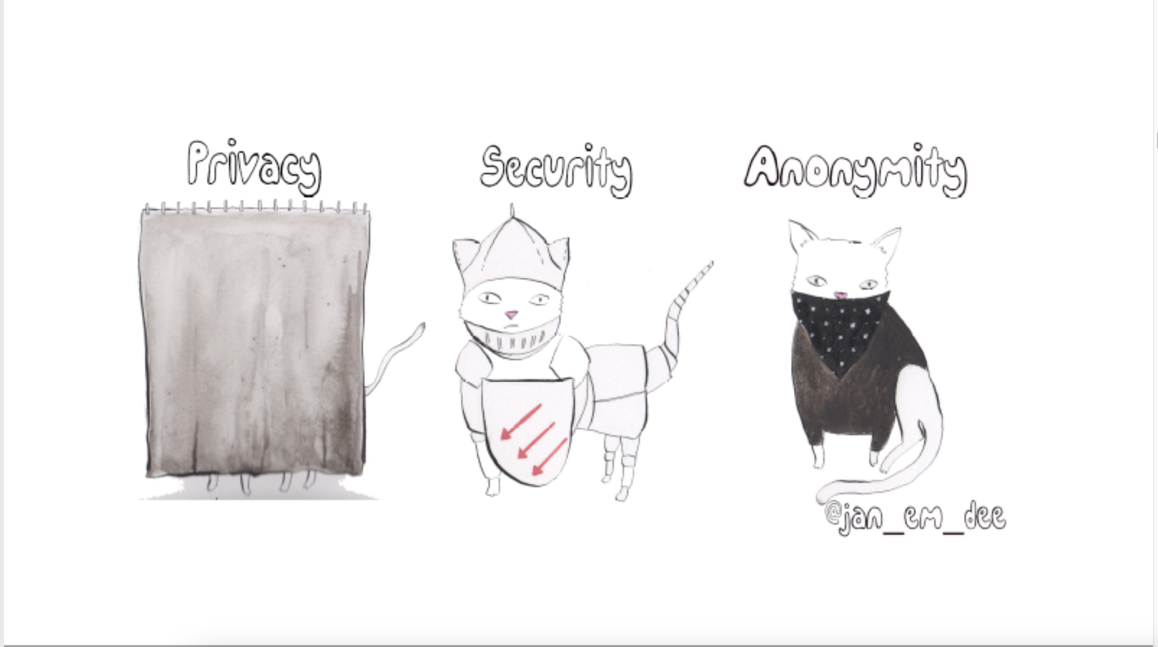

Slide 16
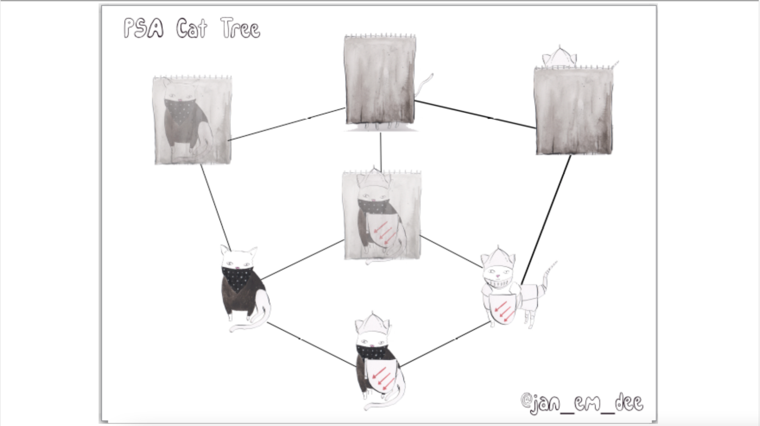

Slide 19
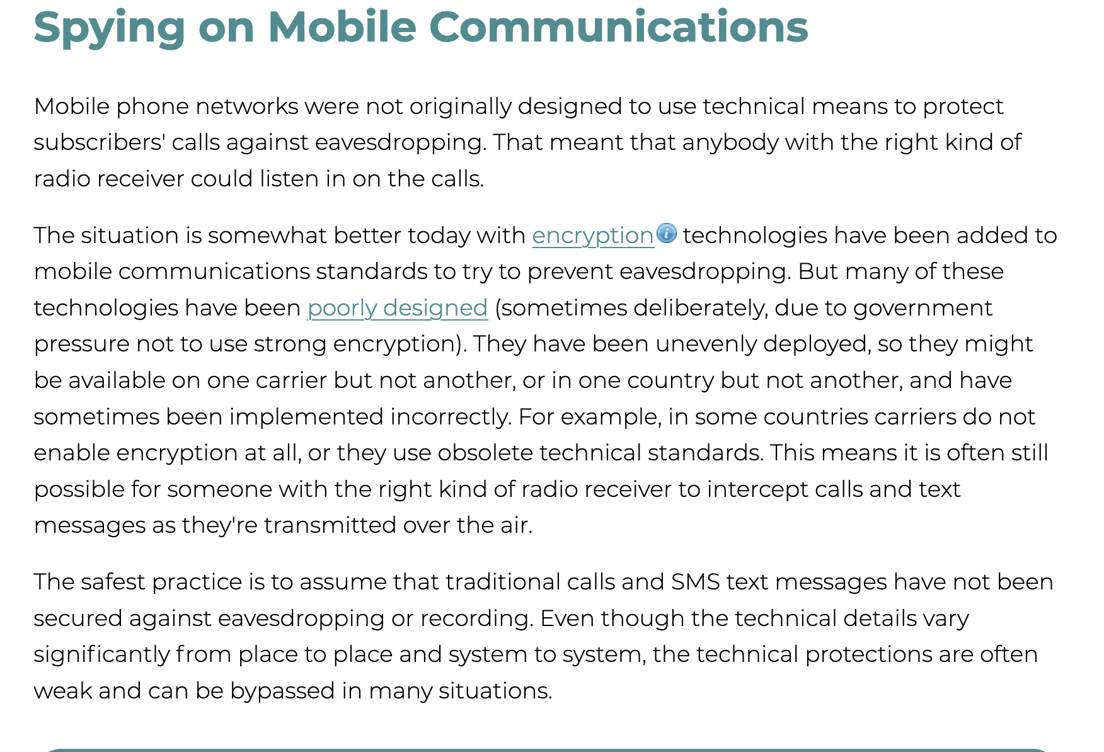

Slide 20
It’s not just about data
It’s about habits

Slide 21
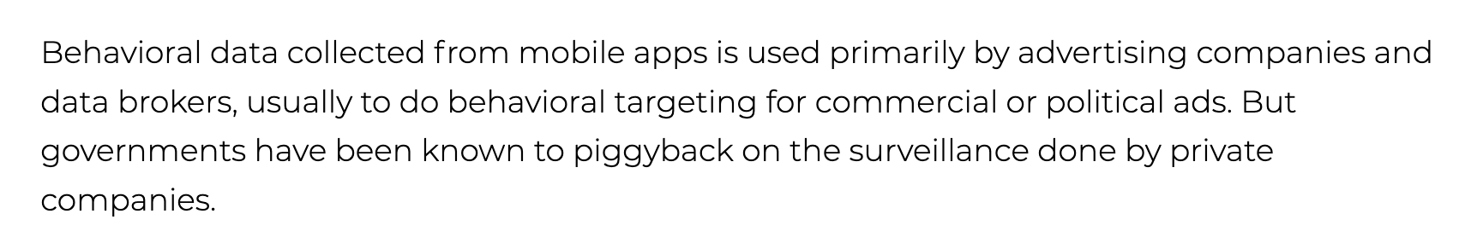

Slide 22
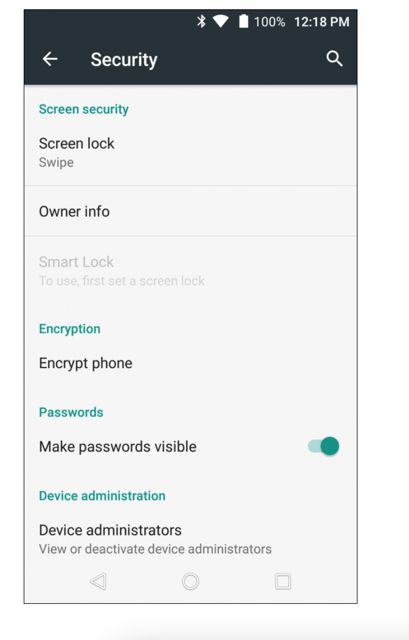
Security Settings
Get to know your settings!
UPDATE YOUR PHONE!
Settings -> Security
Screen Lock
Phone Encryption
Sim Lock Options
Other

Slide 23
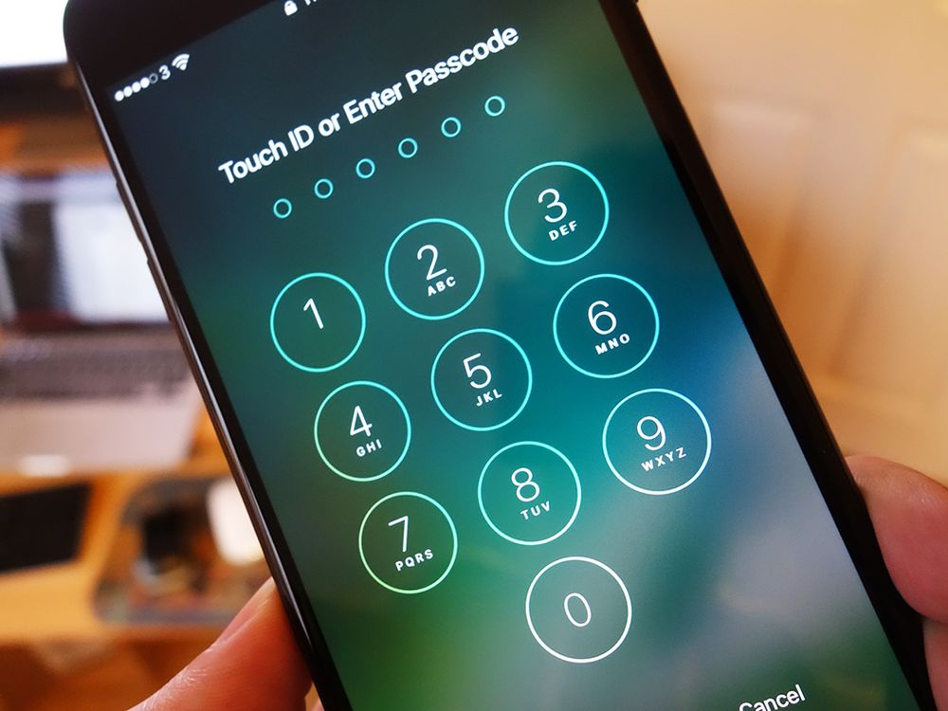
Passwords!
Screen Lock
Numeric/AlphaNumeric (6-10 characters)
Pattern
FaceID/Fingerprint
Password Managers
BitWarden
2FA Apps
Authy
Google Authenticator
FreeOTP

Slide 24
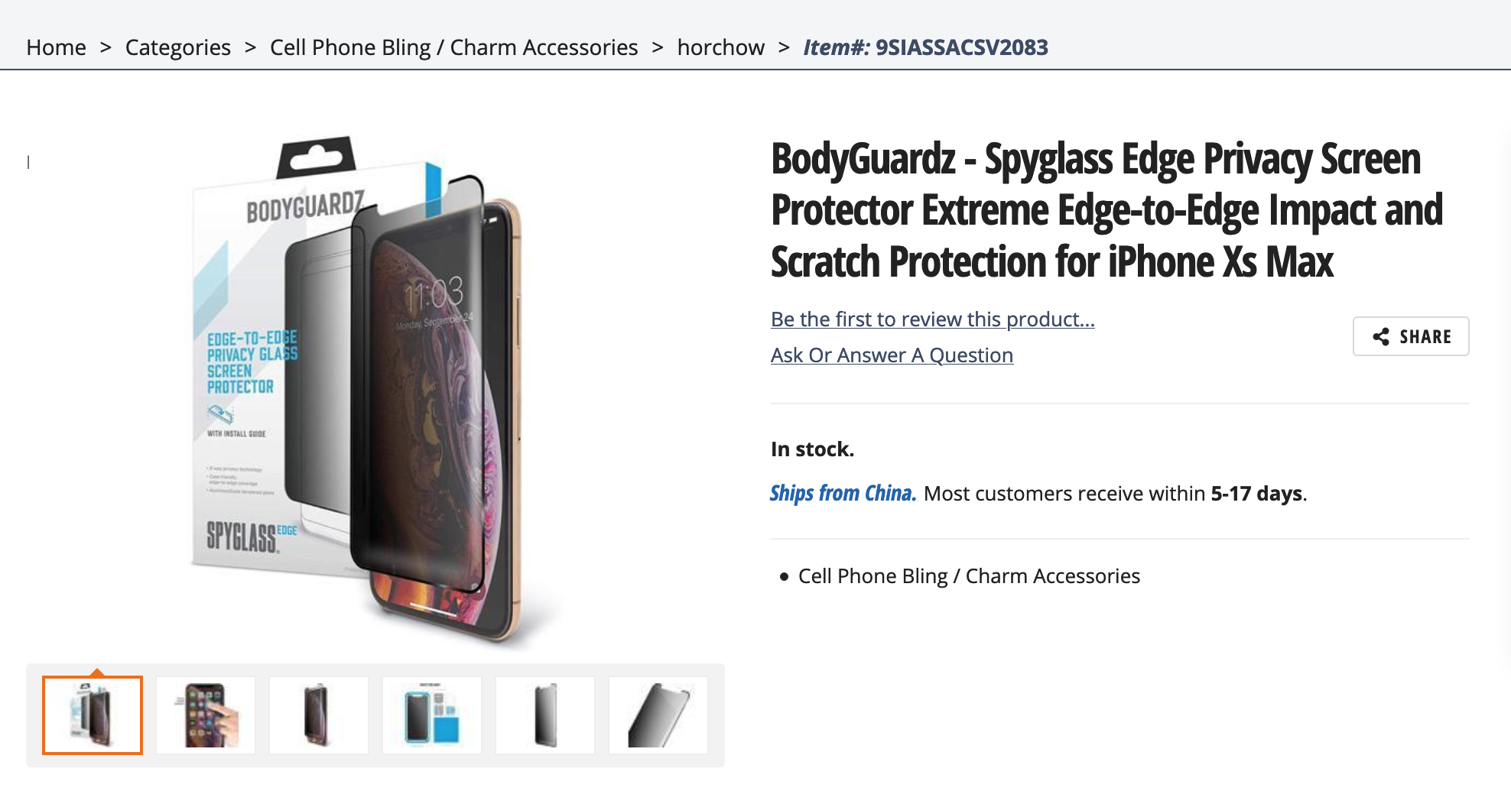
Passwords!

Slide 25
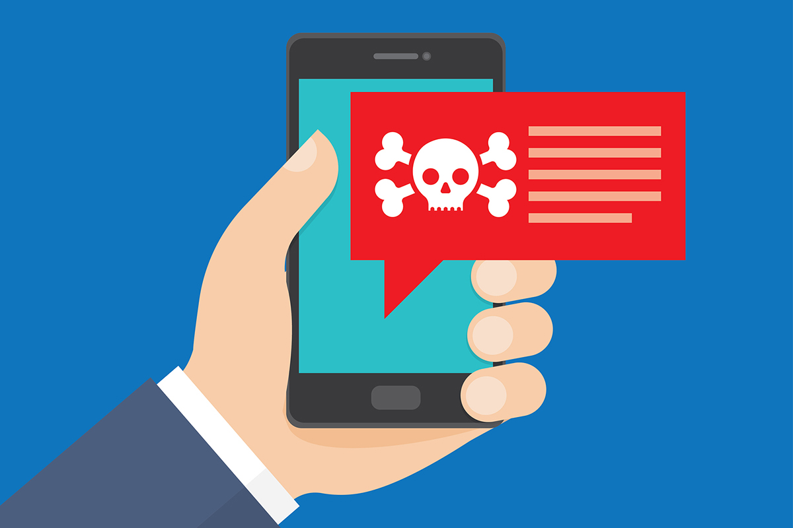
Access
Digital Access
Malware
Texts/Email
Be aware of links from unknown numbers and emails (spam? phishing?)
Unverified Apps
Access
Phone Content
Camera/Mic/GPS
Physical Access
Who has access to your physical phone?

Slide 26
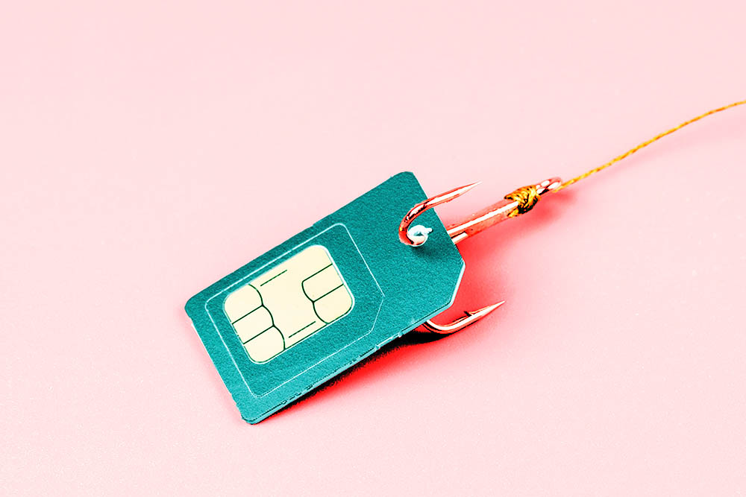
SIM Swapping
aka “simjacking”
The process of
obtaining personal information on a user
convincing their mobile carrier that the hacker is the user
switching their SIM over to the attacker’s phone
gaining access to info and accounts

Slide 27
SIM Swapping
Information obtained through:
Online behavior: phishing emails
Ways to Prevent
Account security:, strong password and strong questions-and-answers (Q&A)
PIN codes: set a separate passcode or PIN for your communications, consider doing it.
IDs: Don’t build your security and identity authentication solely around your phone number.
Authentication apps
- via Norton

Slide 30
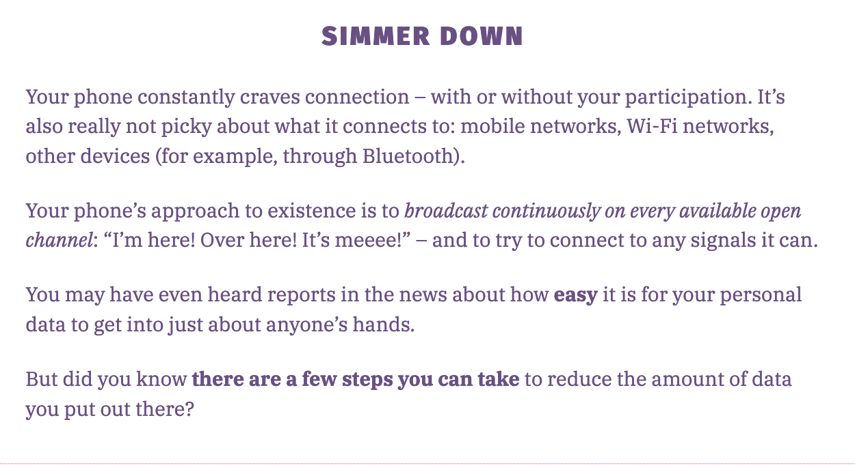

Slide 31
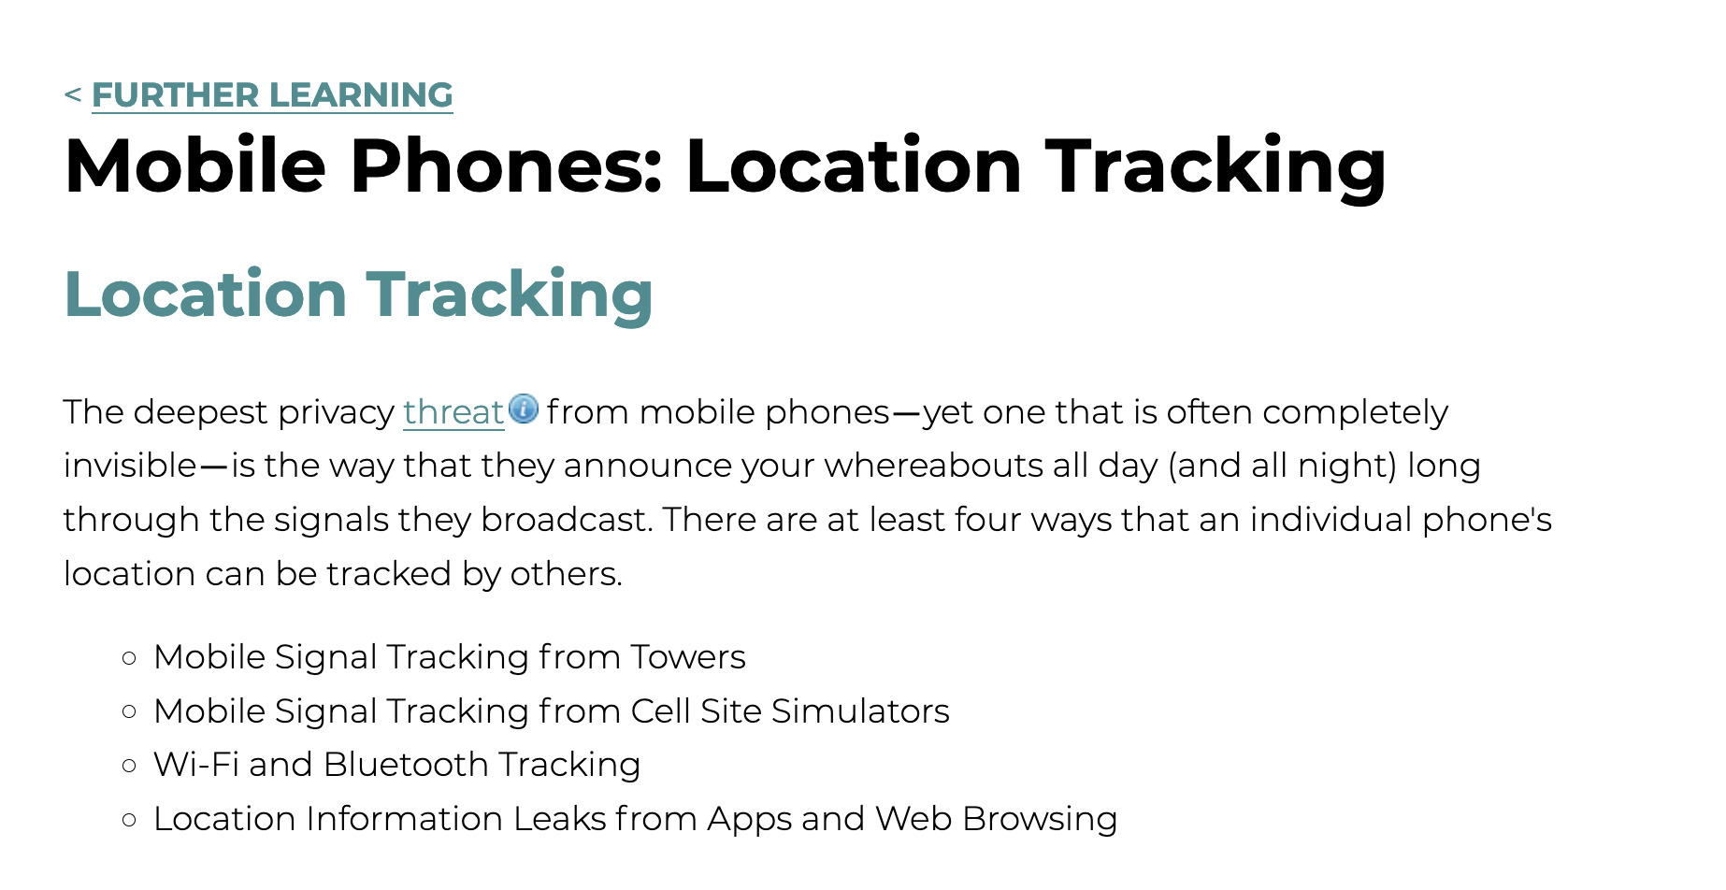

Slide 32
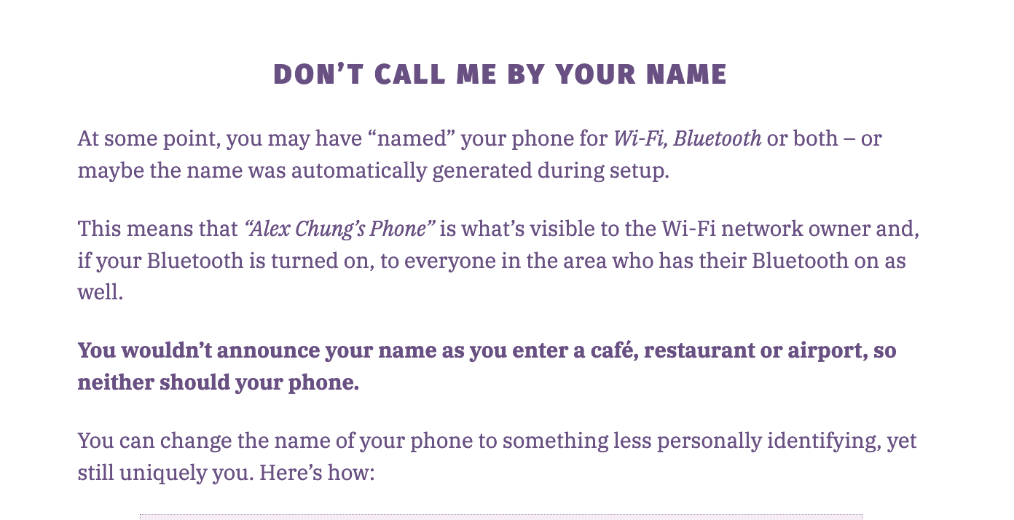
Device Identifiers

Slide 33
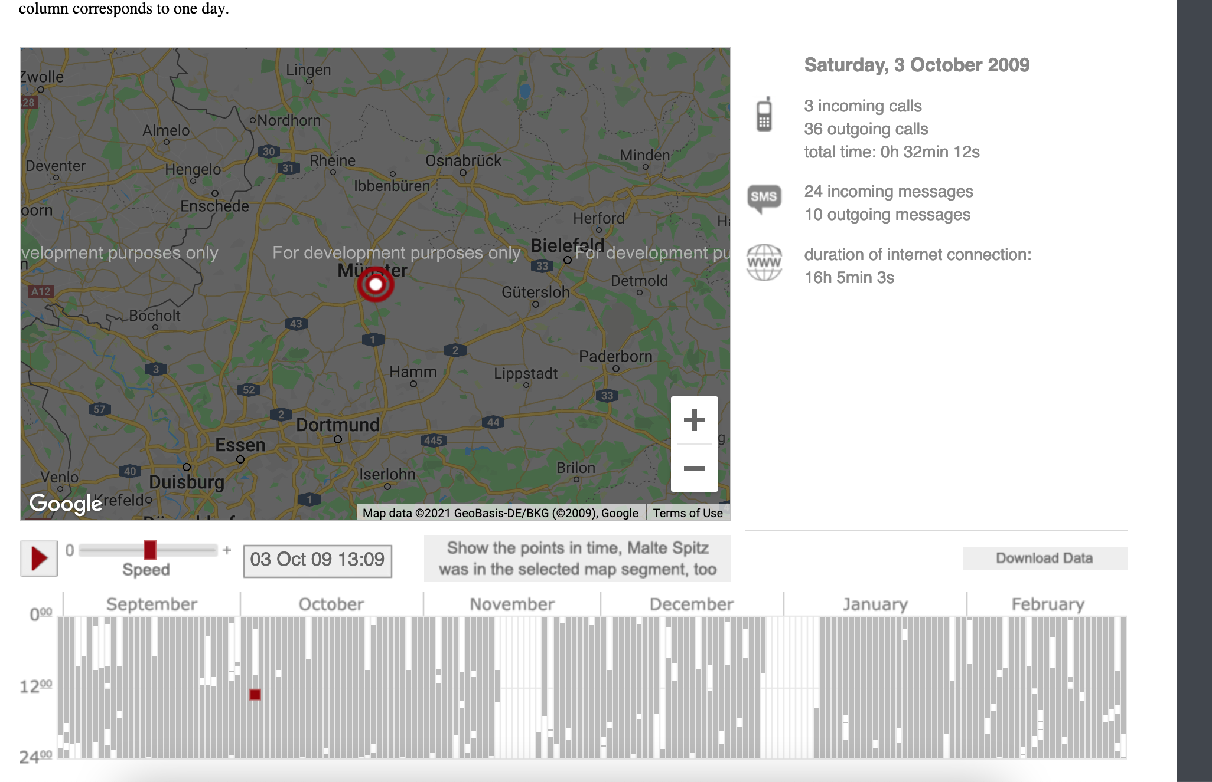
Apps
Permissions/Settings
Access to Phone
Contacts
Keyboard
Camera
Other Apps
Location Data
Limiting/Deleting location information

Slide 34
App Cleanse!
(Via data Detox by ttc)
Declutter Unwanted Apps
Limit Permissions
Replenish with Private Apps
Refresh and Renew!

Slide 35
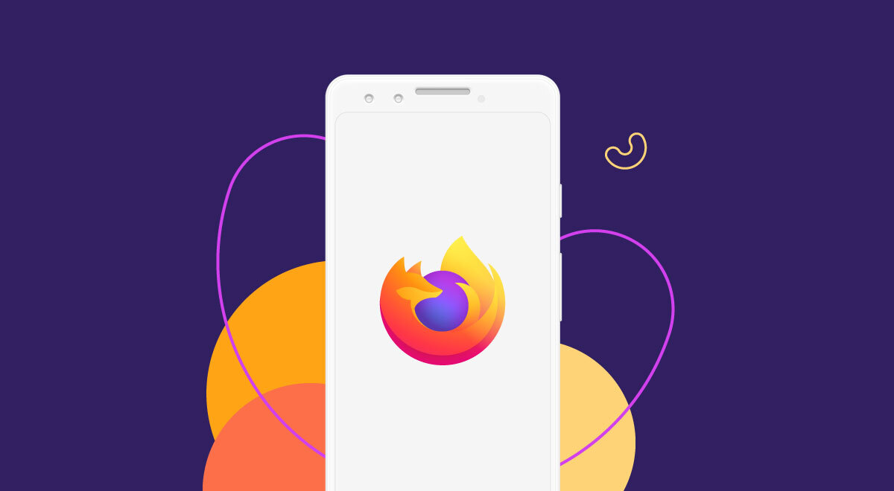
Phone Browsing
To limit data gathered by phone
Erase Browser Data
Use Privacy-Friendly Browser (i.e. Firefox)
Use browser vs. app
Use computer vs. phone browser

Slide 36

Backups
Spring Cleaning!
Aware of what data is on your phone
Images/Videos
Files
Notes
Texts/Messages/Emails
Backup
HardDrive Backup
Cloud Backup
Cryptomator

Slide 37
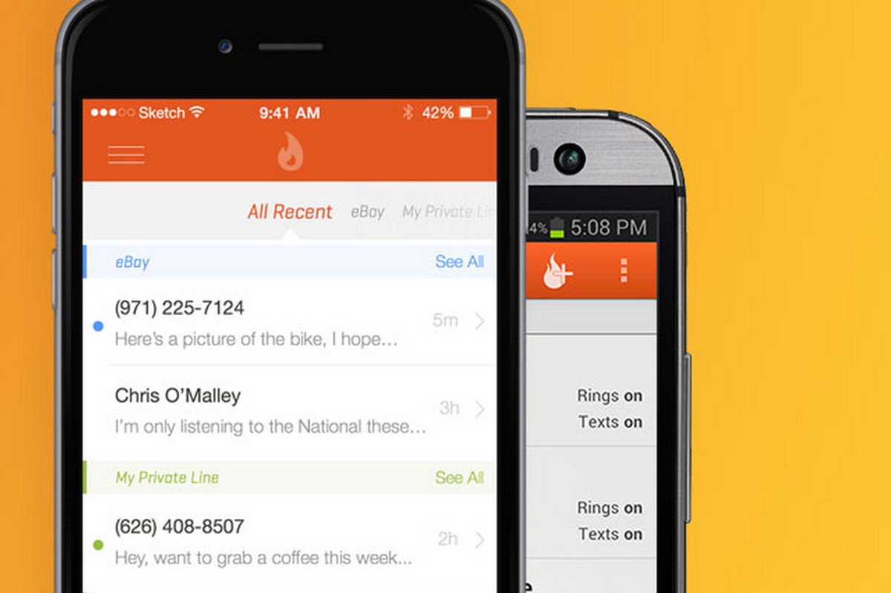
Other numbers
Backup/Fake Phone Numbers
Burner
Google Voice
For use in situations where you don’t want to give out your personal number

Slide 38

Who Are we?
Cypurr Resources
Website- https://cypurr.nyc
Open Collective (Donation/Tshirt)- https://opencollective.com/cypurr-collective
Questions? Comments? Topic Ideas?
Email- cypurr@protonmail.com
Join our email list for updates!
Social Media- FB/Twtitter @cypurrnyc

